Slide 1

ECE 530 Cloud Computing
Ioannis Papapanagiotou
Example: Amazon SQS

Slide 2
Amazon SQS
Amazon Simple Queue Service (SQS)
Fast, scalable and managed.
Enables asynchronous message-based communications between distributed components of an application

Slide 3
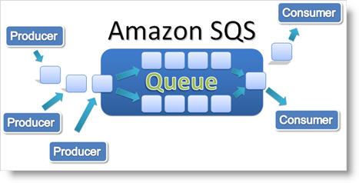
What can it do?
SQS can decouple the components of a cloud application
SQS can be used to transmit high volume of data without losing messages and does not require other service to be available

Slide 4
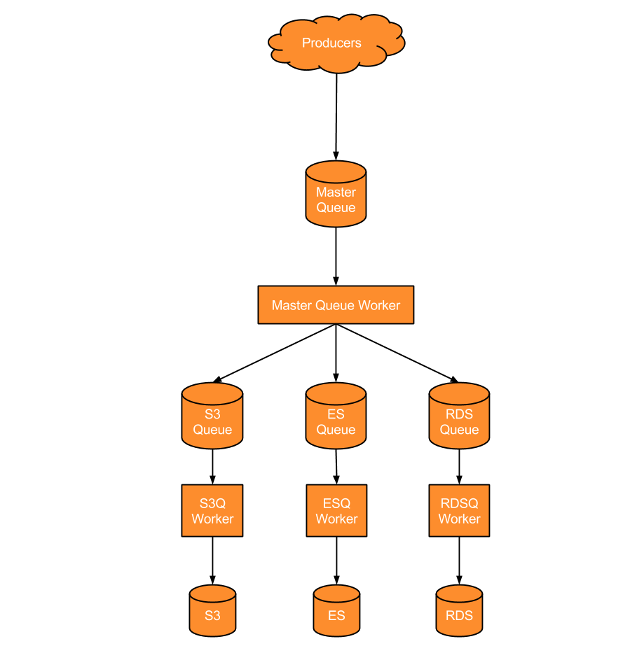
An example of Amazon SQS

Slide 5
Major Features
Redundant Infrastructure
Multiple writers and readers
Configurable setting per queue
Variable message size (up to 256KB)
Access Control
Delay Queues

Slide 6
Message deletion
After a message is consumed from the queue, Amazon SQS does not delete the message
System is distributed: there's no guarantee that the component will actually receive the message
Amazon SQS does not delete the message, and instead, your consuming component must delete the message from the queue after receiving and processing it.

Slide 7
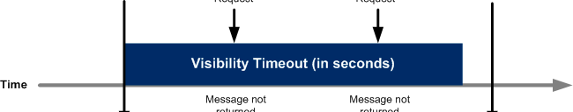
Message Visibility Timeout
We don't want other components in the system receiving and processing the message again.
Amazon SQS blocks them with a visibility timeout,
It is a period of time during which Amazon SQS prevents other consuming components from receiving and processing that message.

Slide 8
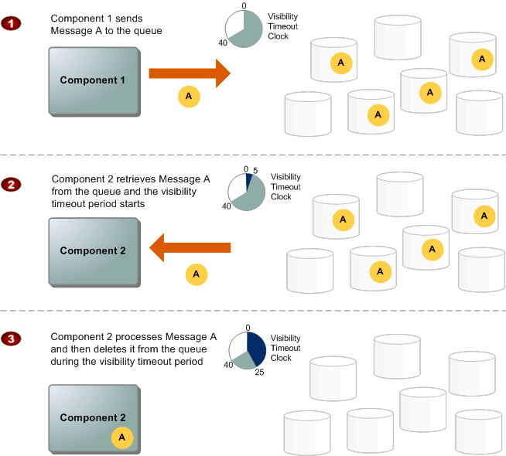
SQS Message Lifecycle
Notes:
Component 1 sends Message A to a queue, and the message is redundantly distributed across the SQS servers.
When Component 2 is ready to process a message, it retrieves messages from the queue, and Message A is returned. While Message A is being processed, it remains in the queue and is not returned to subsequent receive requests for the duration of the visibility timeout.
Component 2 deletes Message A from the queue to avoid the message being received and processed again once the visibility timeout expires.

Slide 9
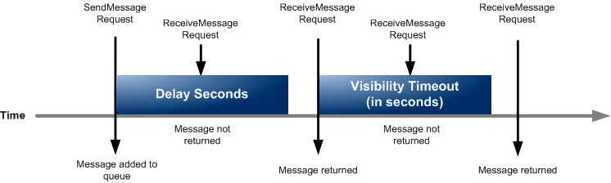
Delay Queues
Delay queues allow you to postpone the delivery of new messages in a queue for a specific number of seconds.
If you create a delay queue, any message that you send to that queue will be invisible to consumers for the duration of the delay period.
Delay queues are similar to visibility timeouts in that both features make messages unavailable to consumers for a specific period of time.
The difference between delay queues and visibility timeouts is that for delay queues, a message is hidden when it is first added to the queue, whereas for visibility timeouts, a message is hidden only after a message is retrieved from the queue.

